Slide 1
Introduction
to Programming

Slide 2
Introduction
Course Details:
Programming Language
Python Basics
Python Developer Environment
Functional Programming
Object Oriented Programming
Error Handling
Modules
File I/O
Uses Of Python on Other Tech Field

Slide 3
Introduction to Python

Slide 4


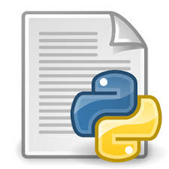

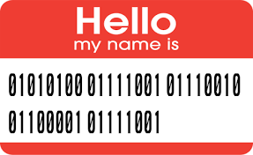
Introduction to Python Programming
What is a Programming Language ?

Slide 5
Introduction to Python Programming
What is a Programming Language ?
Why do we need a translator?
To convert high-level language code to the binary language code which the machine can understand.
Translator
Compiler
Interpreter

Slide 6
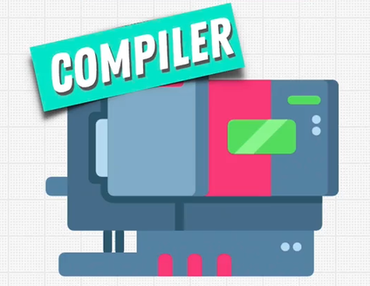
Compiler
It is a software which convert source code to binary code. (All at once)
code
Executable
Linux
no need of extention
Private Code
Faster Execution
Fully Optimized
No portability
Extra Compilation
Windows:
.exe, .bat, .msi
Mac
.app

Slide 7
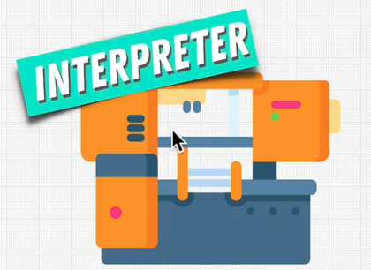
Interpreter
It is a software that converts source code to binary code. (line by line)
It never generates executable
Example: Browser (When we go to some site it loads HTML, CSS, JS...) and generate the webpage
code
Interpreter
Portable
Easy Debugging
Require interpreter
Slower

Slide 8
What is Python is it Compiled or Interpreted Language?
Hybrid (it has benefit of the both)
Source code
Compiler
Byte Code
Interpreter
(Windows)
Interpreter
(Linux)
Interpreter
(Mac)

Slide 9
What is Python is it Compiled or Interpreted Language?
Task:
Create a folder
Create a python file (hello.py)
Run the file
Did yo see bytecode ??

Slide 10
What is Python is it Compiled or Interpreted Language?
Task:
Open Command Prompt / Terminal
Follow the following commands:
python (interactive terminal appears)
import py_compile
py_compile.compile(hello.py)
Did yo see bytecode ??
There must be .pyc file
which is the bytecode

Slide 11
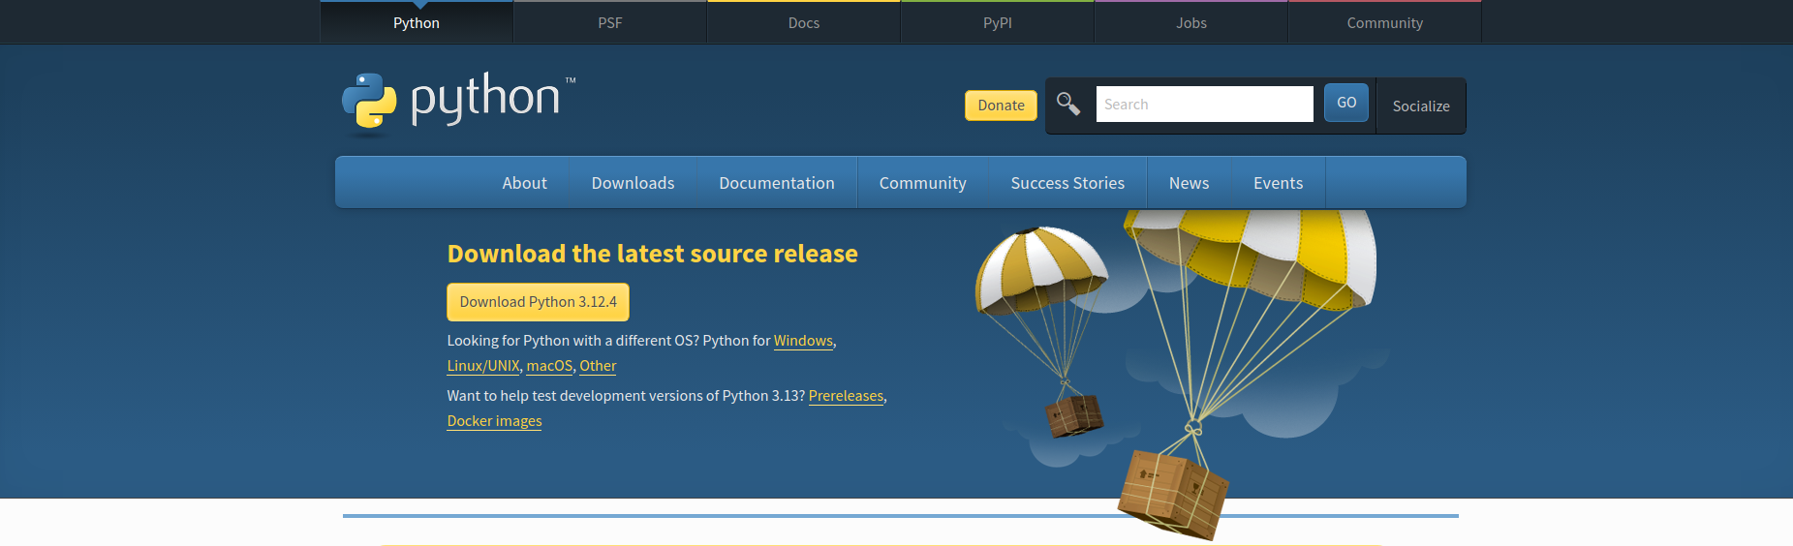
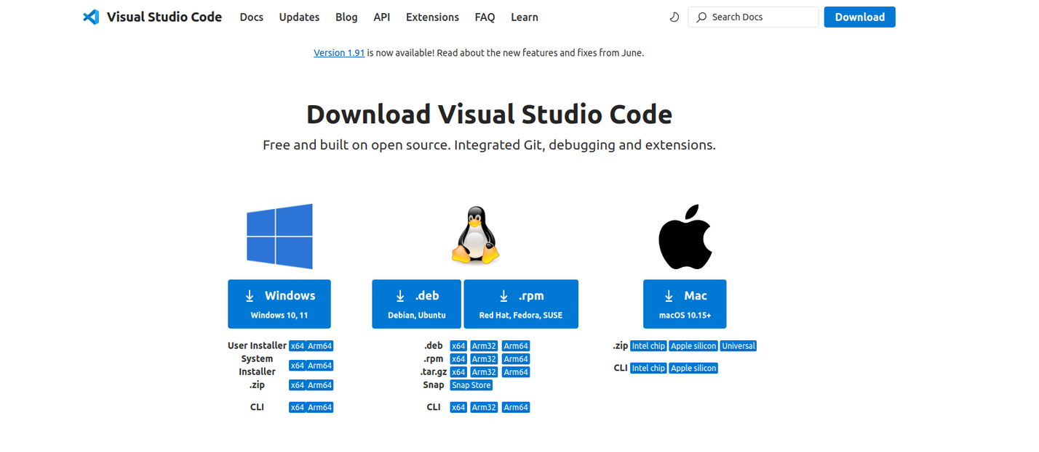
Installation
Visit the official Python website
Download the file
Install it
Check installation is successful
What did we just installed ?
Install VS CODE

Slide 12

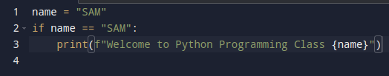
Indention
improve readability
indicate a block of code
example:
Which one is correct?

Slide 13
REPL
Read Evaluate Print Loop
Interactive python shell
Open Command Prompt / Terminal
Type Python
Example:
Arithematic operations

Slide 14
Getting started with the your first Python Program

Slide 15

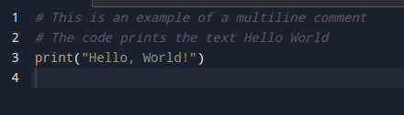

Python Comments
Single-Line Comments
Multi-Line Comments

Slide 16
Python Comments
Use of the Comments ??
For future references, to make code readable.
For debugging.
For code collaboration, comments help peer developers to understand each other's code.

Slide 17
Python Fundamentals
Python Variables and Literals
Literals:
literals are raw data given in a variable or constant
It allows to recognize the type and value of the data at runtime, ensuring the correct handling and processing of the data
Numeric Literals:
Integer ==> 10, -5, 0
Float ==> 3.14, -0.02
Complex Number ==> 1+j4
String:
‘Hello’, “World”

Slide 18
Python Fundamentals
Python Variables and Literals
Variables:
name = ‘Sam’
age = 24
name, age = ‘Sam’, 24
code_1 = code_2 = 940M5G

Slide 19
Python Type Conversion
converting data of one type to another. For example: converting int data to str
There are two types of type conversion in Python.
Implicit Conversion - automatic type conversion
Explicit Conversion - manual type conversion
Task:
Add '10' + 88
What happen ? Is it success ?

Slide 20
Python Type Conversion
Key Points to Remember
Type Conversion is the conversion of an object from one data type to another data type.
Implicit Type Conversion is automatically performed by the Python interpreter.
Python avoids the loss of data in Implicit Type Conversion.
Explicit Type Conversion is also called Type Casting, the data types of objects are converted using predefined functions by the user.
In Type Casting, loss of data may occur as we enforce the object to a specific data type.

Slide 21
Basic Input and Output
Python Output
print('Python Programming is Awsome!!')
What Parameters dose print() contain ??

Slide 22
Basic Input and Output
Python Output
print(object= separator= end= file= flush=)
object - value(s) to be printed
sep (optional) - allows us to separate multiple objects inside print().
end (optional) - allows us to add add specific values like new line "\n", tab "\t"
file (optional) - where the values are printed. It's default value is sys.stdout (screen)
flush (optional) - Boolean specifying if the output is flushed or buffered. Default: False
Let's see example of Input and Output

Slide 23
Python Operators
Arithmetic Operator
Assignment Operator
Comparision Operator
Logical Operator
Bitwise Operator
Special Operator
Let's Learn With Example:

Slide 24
Python Flow Control

Slide 25
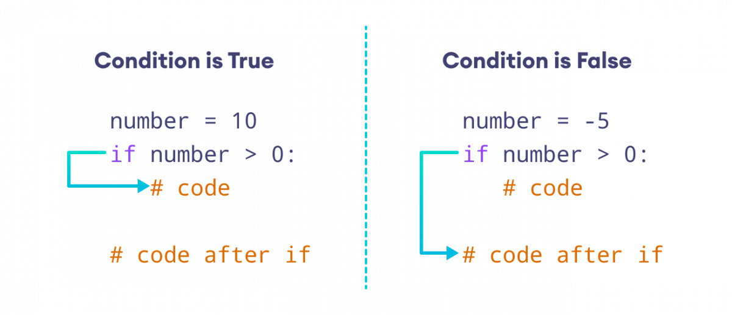
If...else Statement

Slide 26
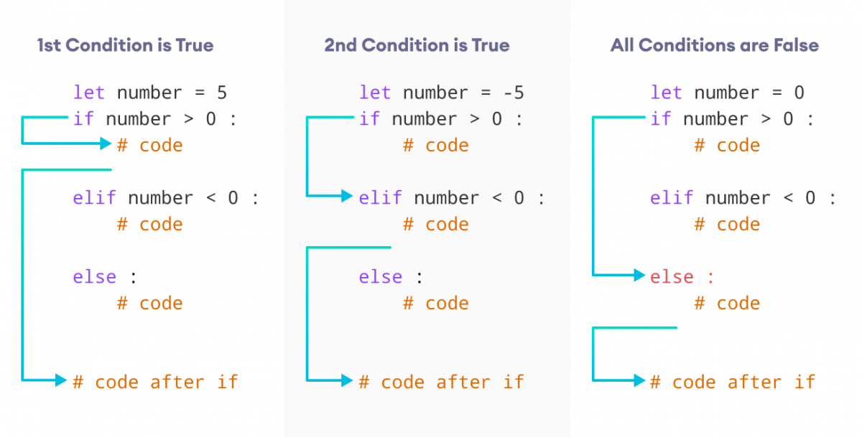
If...else Statement

Slide 27
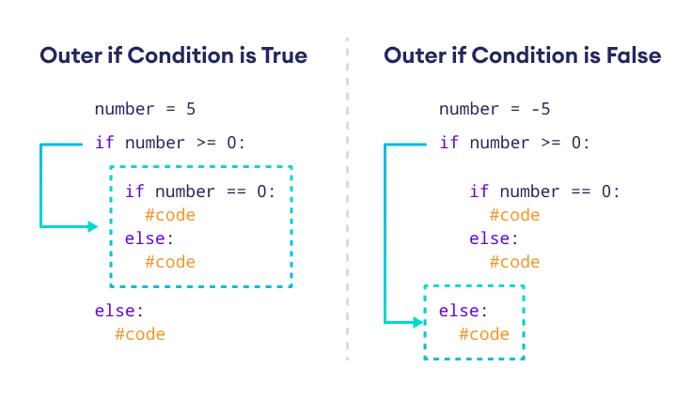
If...else Statement

Slide 28
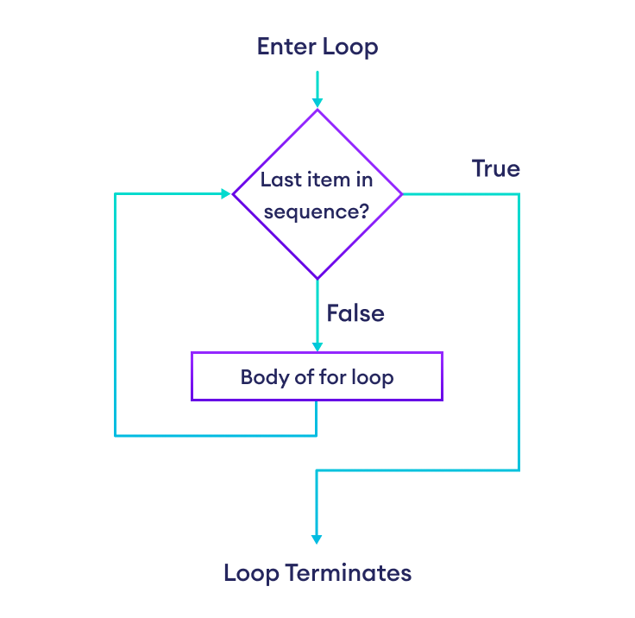
For Loop

Slide 29
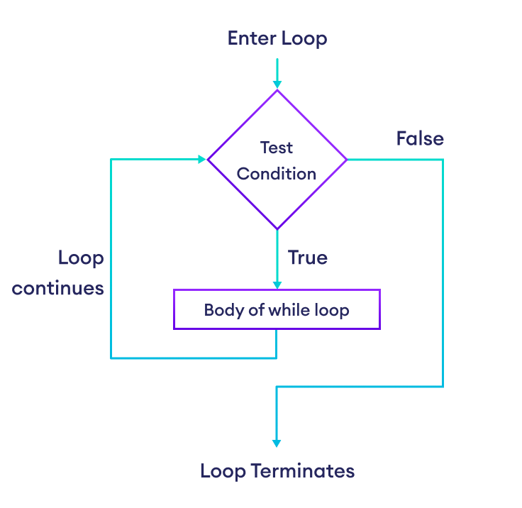
While Loop

Slide 30
While Loop
For Loop
It is used when the number of iteration is unknown
It is used when the number of iteration is known
Minor mistake can cause infinite loop
It always has finite range of loop

Slide 31
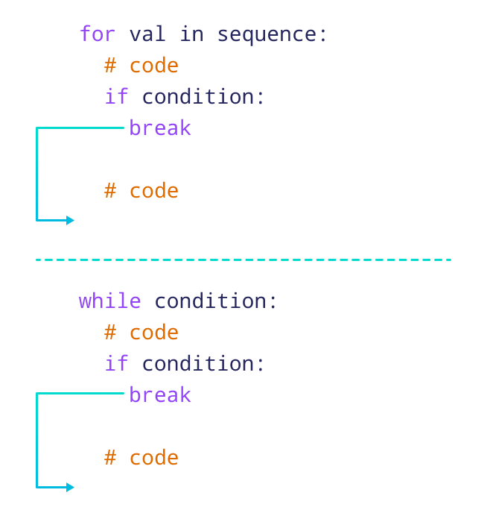
Break Statement
It terminates the loop immediately

Slide 32
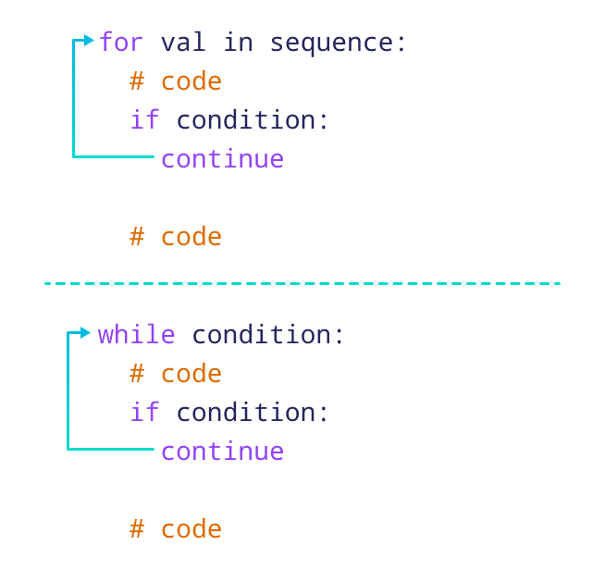
Continue Statement
It skips the current loop and continue the loop again

Slide 33
Break Statement
It terminates the loop immediately

